Slide 1
Today’s lecture
Text categorization introduction
The text categorization process
Task definition
( Example data )
Pre-processing
Feature extraction
Classifier learning
Evaluation

Slide 2
After this lecture...
you can give a few examples of text categorization applications
you can describe the pre-processing needed for text categorization
you can compute the tf-idf weight for a term given its term count, document count, and corpus size
you can evaluate classification results using precision and recall

Slide 3
About text categorization
(or text classification)

Slide 4
Binary classification
Multi-class / one-of classification
Multi-label classification
Notes:
In the book no distinction between multi-class and multi-label

Slide 5
Example applications
Is this task binary, multi-class or multi-label?

Slide 6
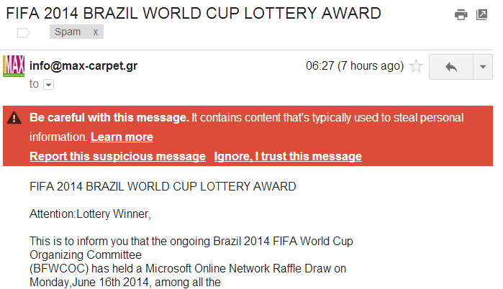
Spam classification

Slide 7
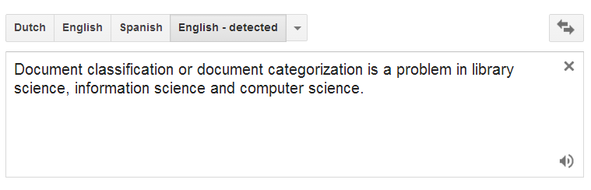
Language identification

Slide 8
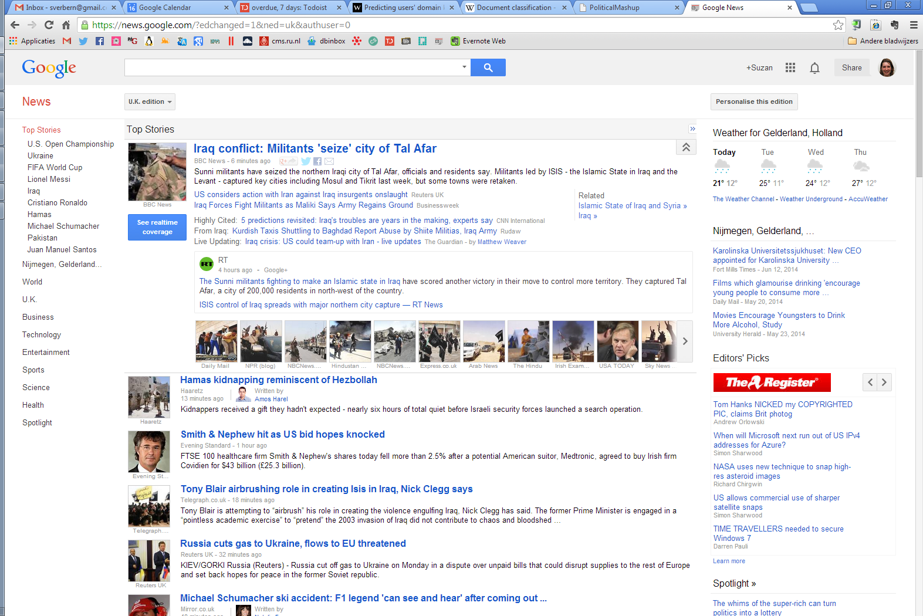
News sectioning

Slide 9
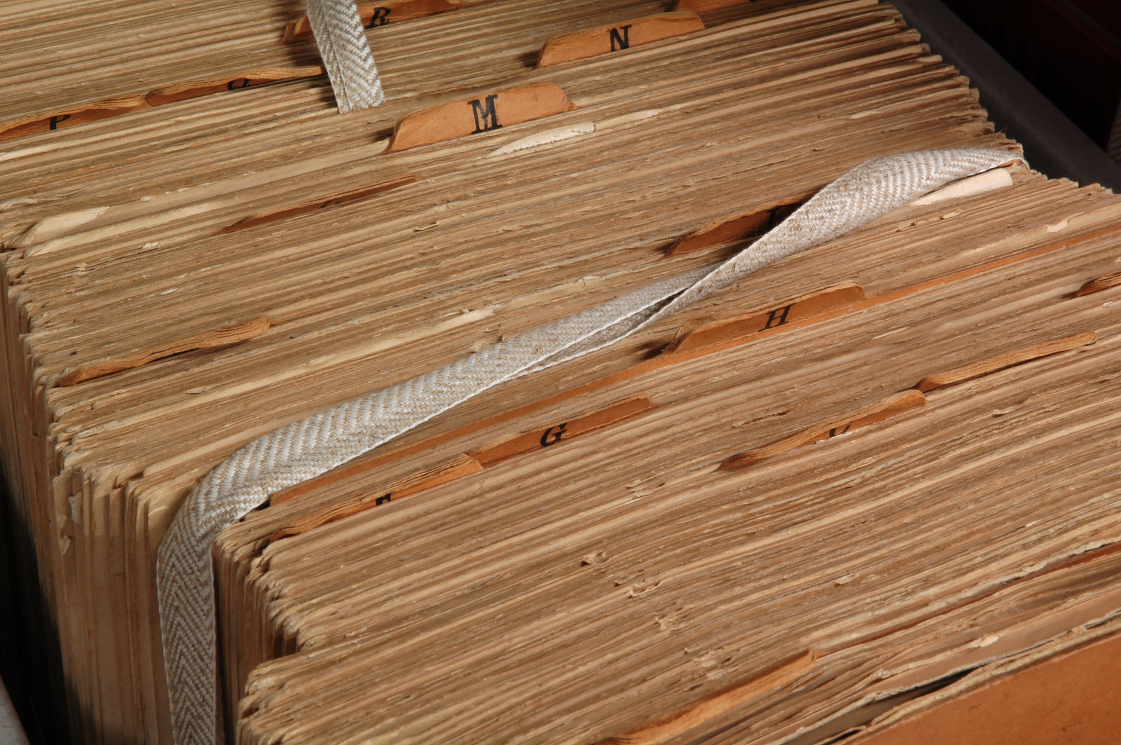
Adding keywords to archived documents

Slide 10
The text categorization process

Slide 11
What is needed for text classification
A definition of the task
Example data
Pre-processing
Feature extraction
Classifier learning
Evaluation

Slide 12
What is needed for text classification
A definition of the task
Example data
Pre-processing
Feature extraction
Classifier learning
Evaluation

Slide 13
Task definition
What is the text unit (a.k.a. ‘document’)?
Complete documents (emails, scientific articles)
Sections (minutes, speeches)
Sentences? (language identification, sentiment classification)
What are the categories?
Spam/no spam
Language
Positive/negative/neutral
Topic
News section
…

Slide 14
What is needed for text classification
A definition of the task
Example data
Pre-processing
Feature extraction
Classifier learning
Evaluation

Slide 15
Pre-processing and feature extraction

Slide 16
Words as features
Doc id | Content | Class
1 | request urgent interest urgent | Spam
2 | assistance low interest deposit | Spam
3 | symposium defense june | No spam
4 | notas symposium deadline june | No spam
5 | registration assistance symposium deadline | ?
Section 15.3:
Each item in the vocabulary becomes a feature/dimension in the vector space
Each document x_{i} is represented as a vector in this space
Each document has a label y_{i}
What is the vocabulary size of this training set?

Slide 17
Pre-processing
We need at least tokenization to get the words
Or we create even lower-level features: character k-grams
E.g. 4-grams:
“you will. To” → you_ ou_w u_wi _wil will ill. ll._ l._T ._To
For most applications, we apply lowercasing and removal of punctuation

Slide 18
Pre-processing
Additional pre-processing steps might include:
Remove stopwords
Lemmatization or stemming
Add phrases as features (e.g. “PhD defense”, “not good”)
Phrases: statistical (bigrams, trigrams) or linguistic (noun phrases)
Only in few domains the addition of phrases has proven to give better results

Slide 19
Pre-processing
Decide on vocabulary size (number of dimensions / number of distinct terms)
Feature selection

Slide 20
Feature selection
Goals:
Dimensionality reduction
Reduce overfitting
Global term selection: overall term frequency (e.g. 3) is used as cut-off (remove rare terms, the long tail)
Local term selection: Each term is scored by a scoring function that captures its degree of correlation with each class it occurs in (for example using the χ² test)
Only the top-n terms are used for classifier training

Slide 21
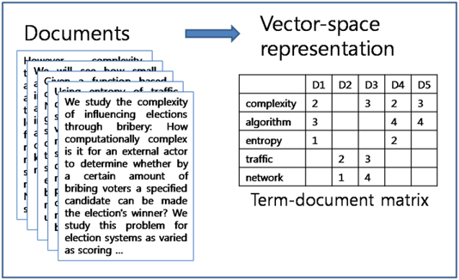
Term-document matrix
Once we have defined the terms in our vocabulary (the features), we assign them weights (feature values)

Slide 22
Term weighting
Compute term weights
Binary: occurrence of term
Integer: term count
Real-valued: more advanced term weighting

Slide 23
Term weighting
Term frequency
The term count tc_{t,d} of term t in document d is defined as the number of times that t occurs in d.
Raw term count is not what we want because:
A document with tc = 10 is more relevant than a document with tc = 1
But not 10 times more relevant
Relevance does not increase proportionally with term frequency.
→ log frequency is more useful:

Slide 24
Term weighting
Inverse document frequency:
Intuition: the most frequent terms are not very informatve
df_{t} is the document frequency, the number of documents that t occurs in
df_{t} is an inverse measure of the informativeness of term t
We define the idf weight of term t as follows:
(N is the number of documents in the collection)
Tf-idf = tf * idf

Slide 25
exercise
We have a collection of 1 Million documents. The term ‘computer’ occurs in 100 documents. What is the inverse document frequency for ‘computer’?
idf = log (N/100) = log (1000000/100) = log (10000) = 4
We have a document with 10 times the word ‘computer’ What is the tf-idf weight for the term ‘computer’ in this document?
tf = 1 + log(10) = 1+1 = 2
tf-idf = 2*4 = 8

Slide 26
What is needed for text classification
A definition of the task
Example data
Pre-processing
Feature extraction
Classifier learning
Evaluation

Slide 27
Classification methods
We generally use an experimental environment in which we can compare multiple algorithms, e.g. Scikit-learn in Python
Estimators that are well-suited for text data:
Naïve Bayes (MultinomialNB in sklearn)
Support Vector Machines (LinearSVC in sklearn)

Slide 28
What is needed for text classification
A definition of the task
Example data
Pre-processing
Feature extraction
Classifier learning
Evaluation

Slide 29
Classifier evaluation
Z&M Section 15.6

Slide 30
Test data
We use a held-out test set for evaluation. Why?
Prevents overfitting on the training set
‘Fair’ evaluation
How?
Split the example data in a training set and a test set
E.g. 80% for training and 20% for testing
Or, in the case of small datasets, a rotating 20% (cross validation)
Define the features and train the classifier on the train set

Slide 31
Evaluation metrics
Why is accuracy often not suitable?
The 2 classes are often unbalanced. High accuracy in one class might mean low accuracy in the other class
Also, we might be more interested in correctness of the labels than in completeness of the labels, or vice versa
Alternative: use precision and recall

Slide 32
Precision and recall
Human classification = reference
Automatic classification
8 true categories
of which 5 assigned
Recall = 5/8
6 assigned categories
of which 5 correct
Precision = 5/6
We also report the mean, the F1:

Slide 33

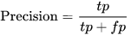
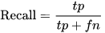
Precision and recall

Slide 34
Evaluation
Suppose that you have manually labelled 100 forum messages for the question “Does the post contain a personal experience? (y/n)”
You trained a classifier and evaluate its performance using cross-validation
The classifier also assigned a yes or no to each message
 | True (reference): yes | True (reference): no
Assigned: yes | 40 | 10
Assigned: no | 20 | 30

Slide 35
Evaluation
 | True (reference): yes | True (reference): no
Assigned: yes | 40 | 10
Assigned: no | 20 | 30
What is the precision for the ‘yes’ class?
40/50 = 0.80
What is the recall for the ‘yes’ class?
40/60 ≈ 0.67

Slide 36
Exercise
We have evaluated a classifier for spam on 1000 messages
 | True (reference): spam | True (reference): no spam
Assigned: spam | 600 | 400
Assigned: no spam | 200 | 800
What is the precision for the ‘spam’ class?
What is the recall for the ‘spam’ class?
What is the precision for the ‘no spam’ class?
What is the recall for the ‘no spam’ class?

Slide 37
Exercise
We have evaluated a classifier for spam on 2000 messages
 | True (reference): spam | True (reference): no spam
Assigned: spam | 600 | 400
Assigned: no spam | 200 | 800
What is the precision for the ‘spam’ class?
What is the recall for the ‘spam’ class?
What is the precision for the ‘no spam’ class?
What is the recall for the ‘no spam’ class?
600/1000 = 0.60
600/800=0.75
800/1000=0.80
800/1200≈0.67

Slide 38
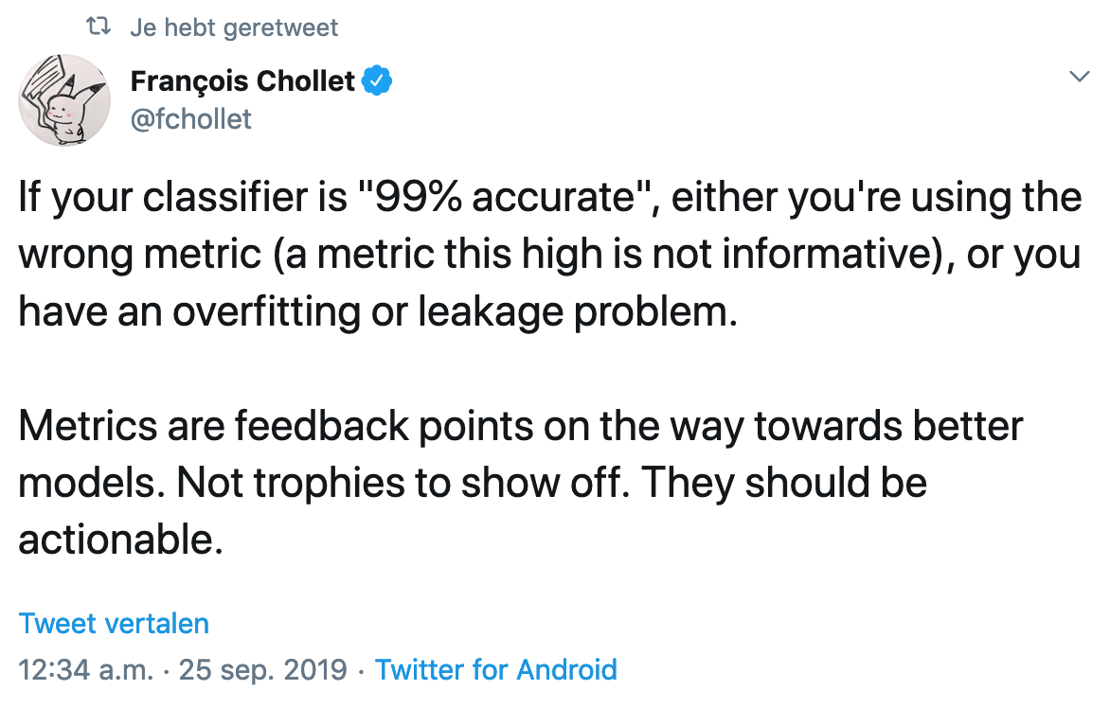
Classifier evaluation

Slide 39
Conclusions

Slide 40
After this lecture…
you can give a few examples of text categorization applications
you can describe the pre-processing needed for text categorization
you can compute the tf-idf weight for a term given its term count, document count, and corpus size
you can compute a Naive Bayes classifier given a toy data set
you can evaluate classification results using precision and recall

